Slide 1
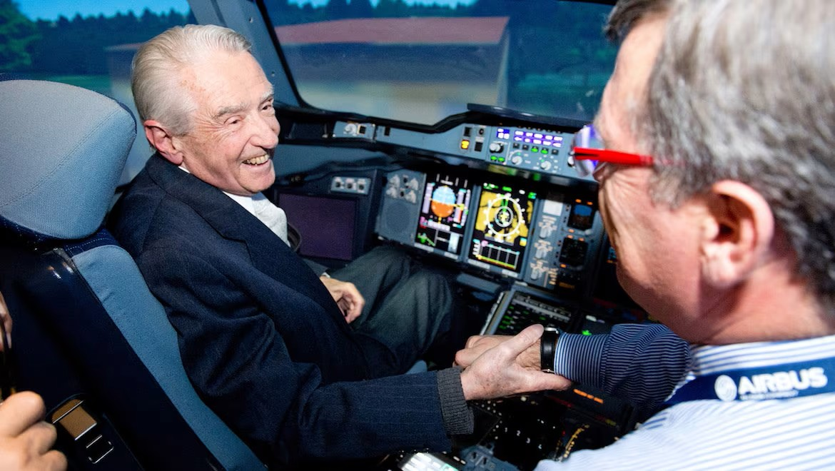
Roger Béteille: The Visionary Engineer Behind Airbus

Slide 2
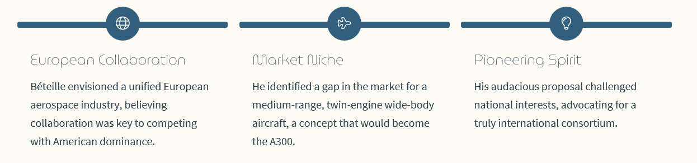
The Audacious Dream: Conceiving a Pan-European Aircraft Company

Slide 3
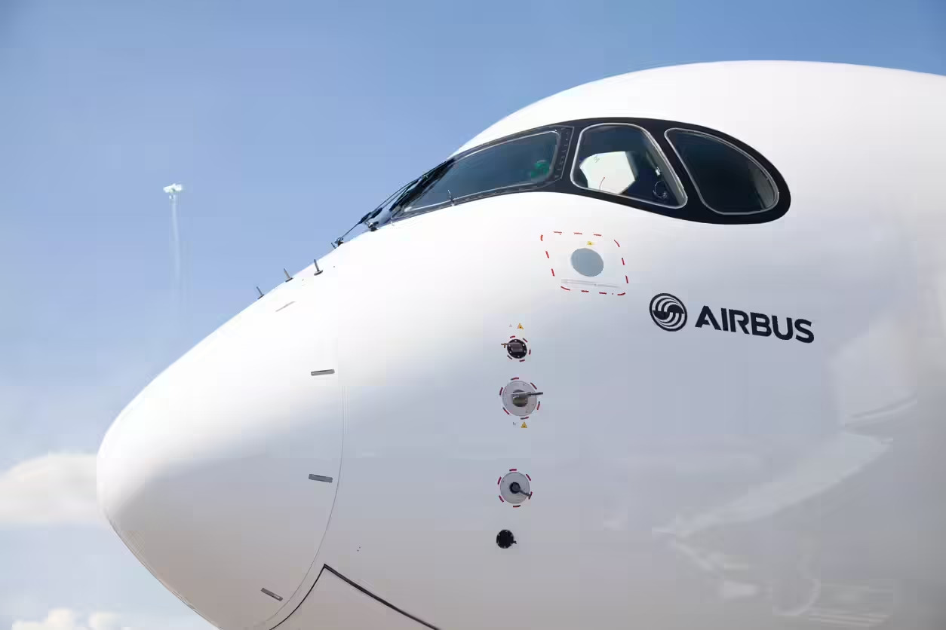
Engineering Excellence: Béteille's Technical Contributions to Airbus
Innovative Design: : Béteille championed a modular design approach, allowing for greater flexibility and cost-effectiveness in aircraft development
Commonality Concept: He pioneered the "commonality" concept, enabling pilots to transition between different Airbus models with minimal retraining, a revolutionary idea.
Fly-by-Wire: His vision paved the way for advanced technologies like fly-by-wire flight controls, enhancing safety and efficiency.

Slide 4

Forging Alliances: Navigating Political & Industrial Complexities
"If we don't succeed in setting up a truly European operation, then we can give up competing with the Americans."
Béteille was a master diplomat, skillfully uniting diverse European partners – France, Germany, and the UK – under a common goal. He overcame significant political and industrial hurdles to secure the necessary funding and support for Airbus.

Slide 5

The A300: Bringing the First European Wide-Body to Life
The A300, launched in 1972, was a bold gamble. It was the world's first twin-engine wide-body aircraft, offering impressive fuel efficiency.
Despite initial sales struggles, Béteille's persistence paid off. The A300 eventually gained traction, proving the viability of Airbus's approach.

Slide 6
